Slide 1
AIR-MED
AUTOMATED INDIVIDUALISED REMOTE ACCESSIBLE MEDICATION EVALUATOR AND DISPENSER
Anantha Krishnan K P
Deva Prakash
Flemin K Sony
Jerrin Mathew George

Slide 2
PROBLEM IDENTIFIED
“ In India approximately, 24,012 people die every day because of delays in getting medical assistance on time “ - 2023 HSTP : Health Systems Transformation Platform Article
Time Sensitivity: Existing logistics solutions often struggle with time-sensitive in emergency medical situations.
Unavailability of doctor: expert doctors in remote areas
Adaptability: Conventional aircraft may lack the adaptability required for both urban and remote areas, hindering their effectiveness in diverse environments.

Slide 3
SOLUTIONS
To reduce risk in case of medical emergencies.
Telemedicine: the provision of remote clinical services, via real-time two-way communication between the patient and the healthcare provider, using electronic audio and visual means.
Smooth transition to horizontal flight, facilitating efficient long-distance, high-speed aerial operations.
To take off and land without the use of a runway

Slide 4
INTRODUCTION
Introduce the increasing need for advanced aerial logistics solutions to overcome challenges in traditional methods.
Smart medical kit : various sensors integrated
Present AIRMED as an innovative and versatile solution designed to address these challenges effectively.

Slide 5
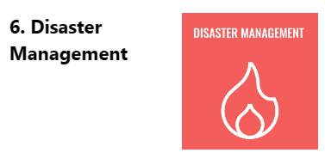
SDG Goal : Disaster Management
Enhance Resilience & Preparedness for Effective Disaster Management
Create platforms for efficient coordination among first responders, organizations, and communities during disaster response.
Empower communities to build resilience through education, training, and planning.

Slide 6
OBJECTIVE
Develop a quad-plane VTOL aircraft with a pusher setup to enable vertical takeoff and landing (VTOL) capabilities.
Design wings to facilitate dual functionality, allowing the aircraft to operate as both a quadcopter and a fixed-wing aircraft.
Establish partnerships with healthcare organizations services to deploy the aircraft for critical applications.
Monitor the vitals of the patient in case of emergency.

Slide 7
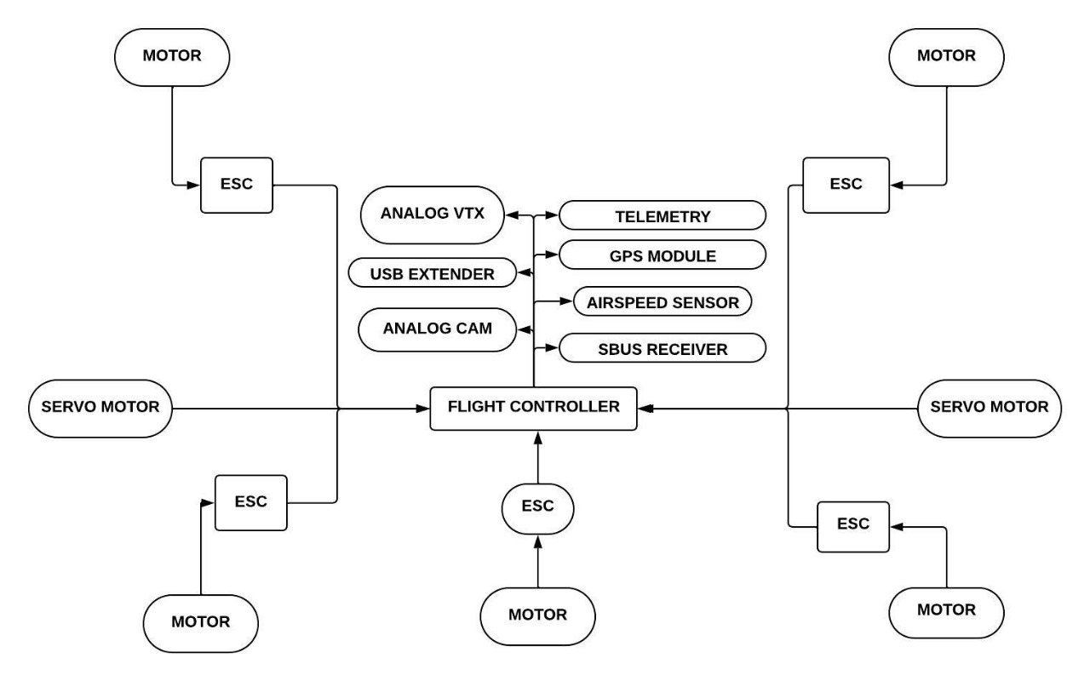
BLOCK DIAGRAM

Slide 8
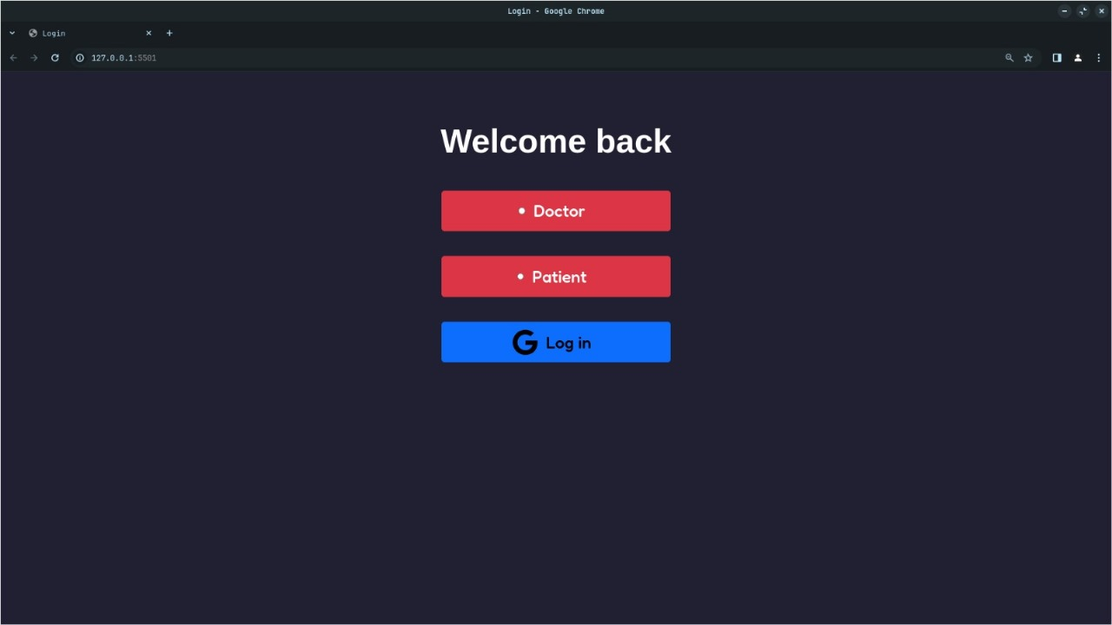
INTRODUCTION TO OUR WEBSITE

Slide 9
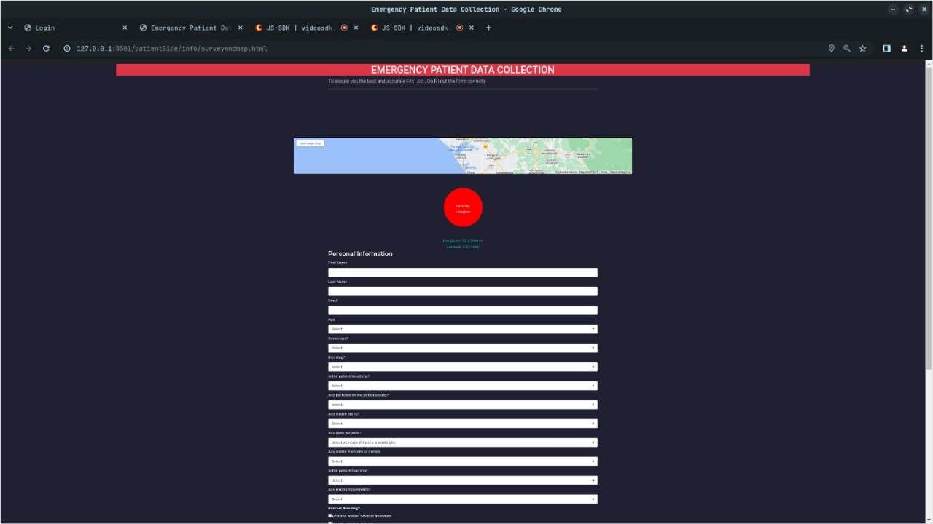

Slide 10
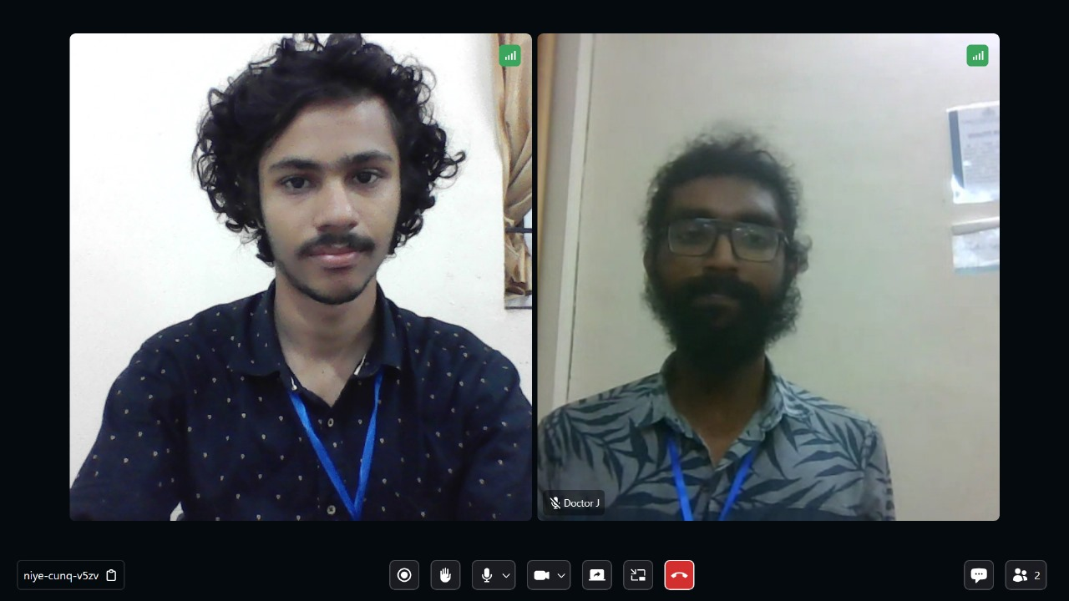
Video Call Feature

Slide 11
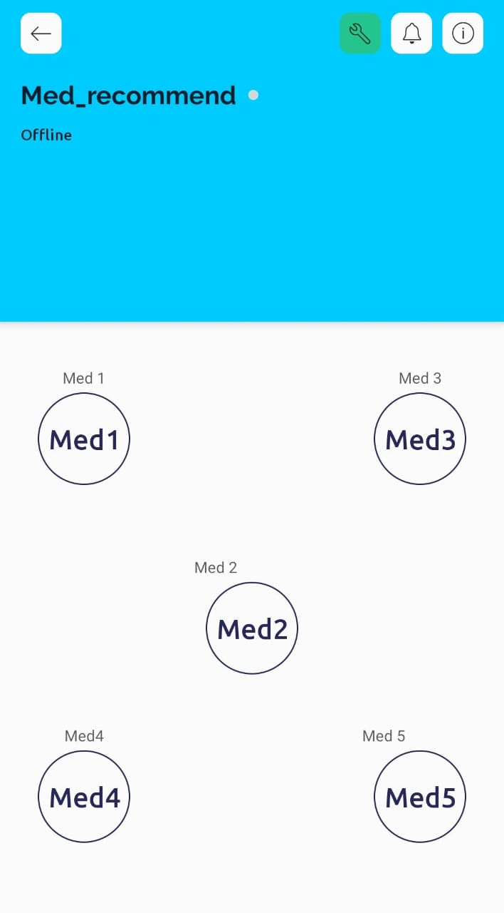
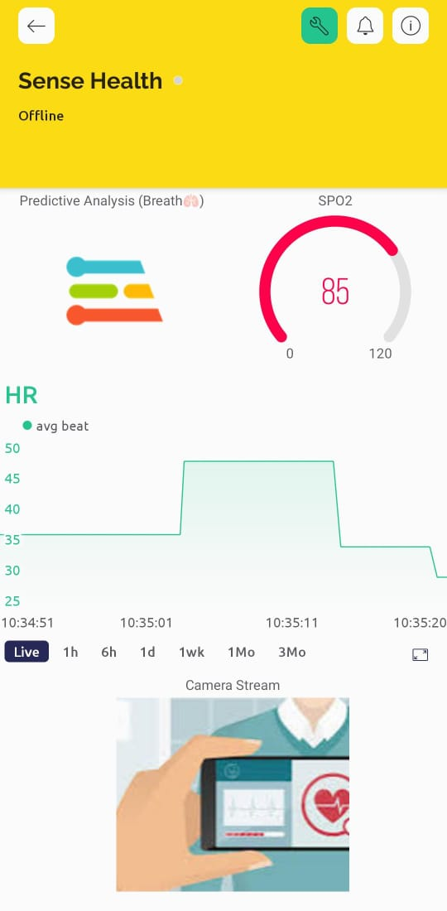
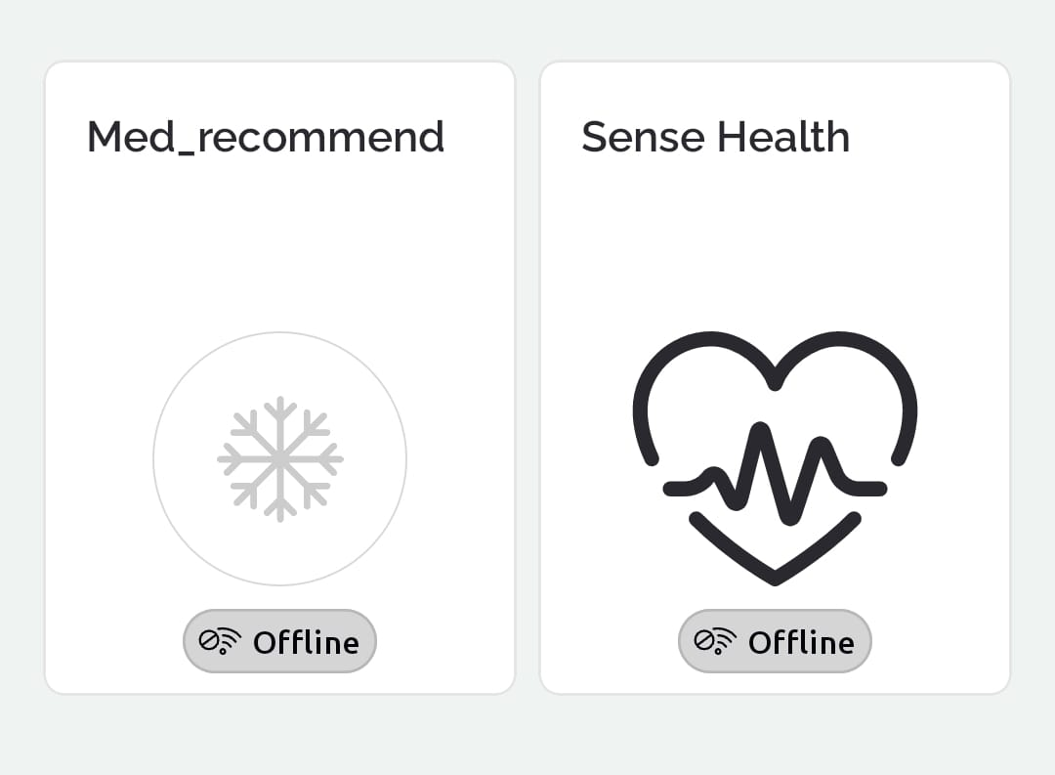
Blynk Interface

Slide 12
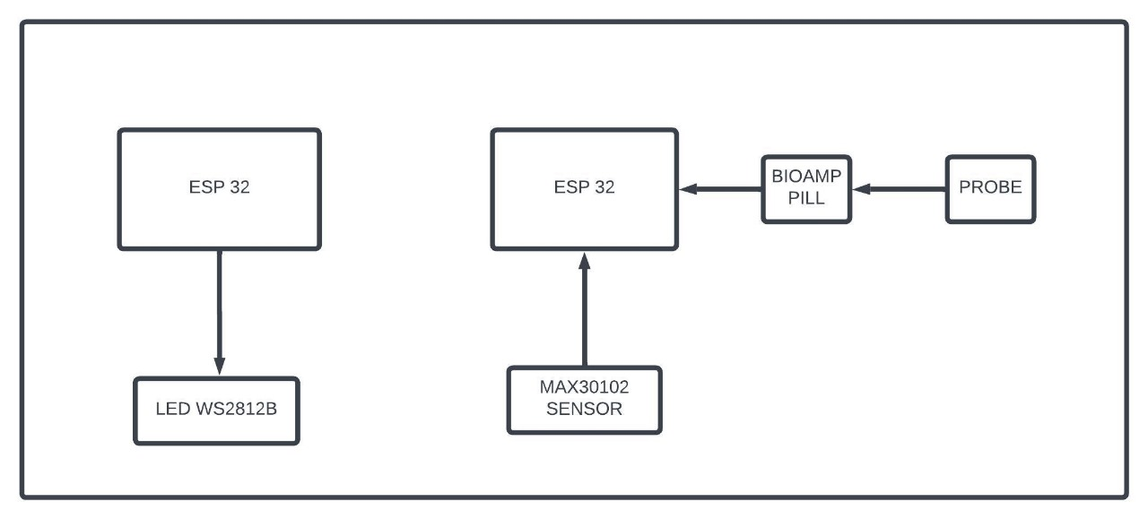
SMART MEDICAL KIT
Medicine illuminator
Wearable vitals monitor

Slide 13
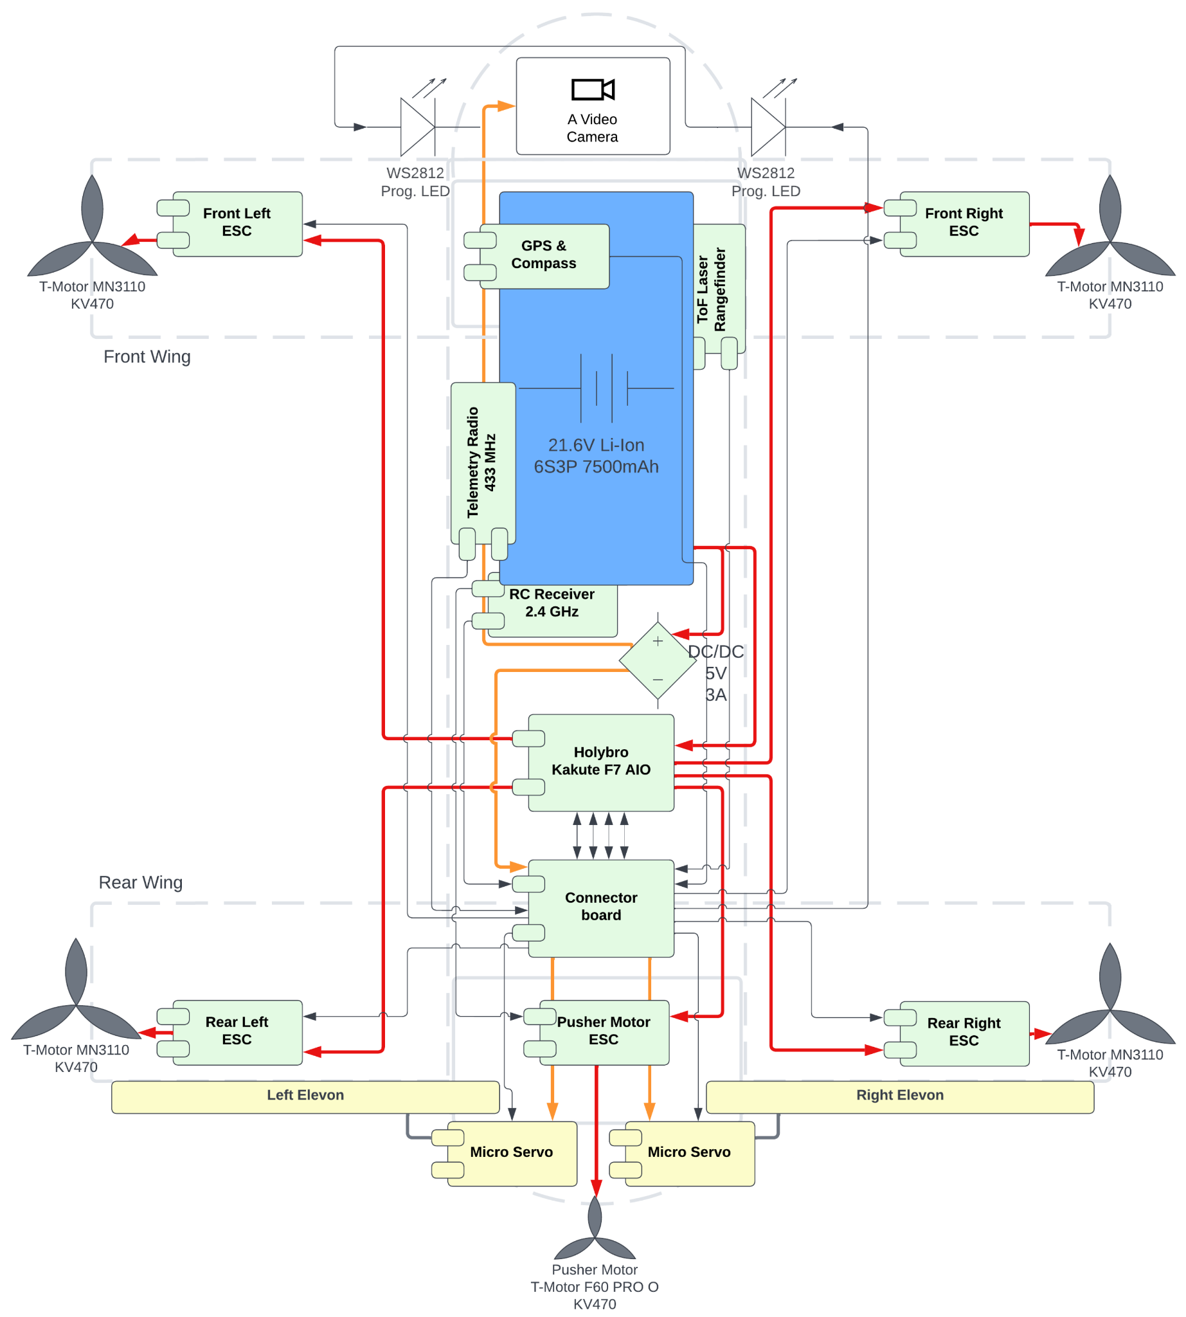
CIRCUIT DIAGRAM

Slide 14
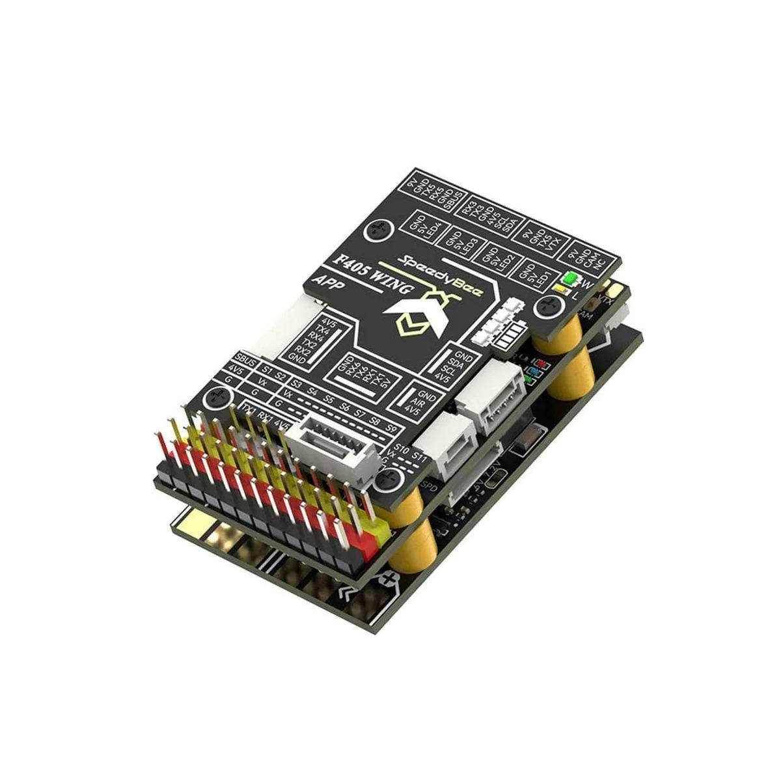
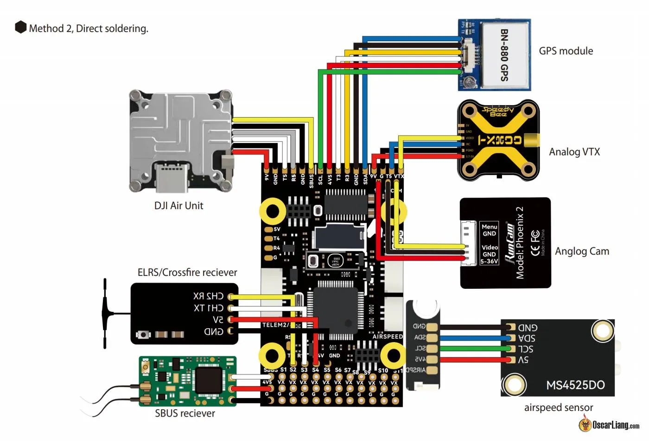
SPEEDY BEE FLIGHT CONTROLLER

Slide 15
ADVANTAGES
Life-saving Deliveries: They can deliver medical supplies, to emergency situations quicker, potentially saving lives in critical moments.
Access to Remote Areas: Drones can reach areas inaccessible to ground vehicles, such as rural locations, disaster zones, or areas with poor infrastructure, enabling timely medical assistance.
Minimal Human Risk: In hazardous situations like natural disasters or conflict zones, sending drones instead of human responders reduces the risk to medical personnel.

Slide 16
Other Possible Use Cases
Specialized for Medicine Transport. Especially useful in remote areas, villages etc.
Use in developing or enhancing early warning systems using real-time data. (One Target of Disaster Management SDG) ,
For example in: Monitoring Wildfires, Flooded areas, earthquake-hit, and other disaster prone areas.
Lockdown use cases : Crowd Control, Awareness,
Use in wider cases

Slide 17
Future Modification
Predictive Analysis: Abnormal breathing patterns can be determined by using
MQTT: The Standard for IoT Messaging, A lightweight messaging protocol for small sensors and mobile devices, optimized for high-latency or unreliable networks,
Forecasting using predictive analytics
Usage of BioAmp EXG Pill : For more vitals

Slide 18
CONCLUSION
In conclusion, the VTOL AIRMED project represents a pioneering venture in the realm of aerial logistics, with a specific focus on critical applications such as telemedicine. As the project progresses, the VTOL AIRMED holds the potential to redefine standards in aerial logistics, offering a versatile solution.

Slide 19
THANK YOU

